Slide 1
SMART AI DIGITAL HEALTH MONITORING REMAINDER

Slide 2

Alzheimer’s patients problems
Many Alzheimer’s patients struggle to remember daily tasks , medication schedules, and important activities.
This leads to missed medications , confusion , and dependency on caregivers.
With growing Alzheimer’s cases worldwide , there’s a need for a simple , gentle reminder system that supports patient independence and caregiver coordination

Slide 3



solution overview
Gentle reminder is a web-based and mobile-friendly application designed for Alzheimer’s patients.
It deliver’s personalized audio-visual alerts for meditation , hydration , meals , and daily routines .
It features caregiver-assisted scheduling , soothing alert tones , and video message playback for emotional connection.

Slide 4
AI now a Days in this world:
Ai Digital monitoring and Health scheduling system is one of the most vital topics in AI Technology in recent trend.
AI is the imitation of Human’s Natural Brainpower processes by machines by using computational methods.
AIML technology is a potentiality of machine that think learn like human being
AI field is interconnected for several branch of research fields for developing techniques are aiming and solving problems , that helpful to our society.

Slide 5

AI is a software think intelligence , in the similar approach the intelligent humans think.
AI is a realize by studying how human brain thinks, and how learn , decision , and work while trying to solve a problem.
AI is integrated with the different fields and play a key role in sectors like Industry , Health care , Agriculture , E –commerce , NASA , Robotics , Transportation and Drug designing etc.,

Slide 6
Alzheimer’s disease (AD) is the most common cause of dementia.
Alzheimer’s is pronounced “ alz-hai-mers ”.
It’s a neurodegenerative disease that affects your brain.
This means it damages and destroys cells in your brain over time.
Eventually , people with AD lose some of their brain functions , including memory and language.
Alzheimer’s disease affects approximately 24 million people worldwide .One in 10 people older than 65 have it .
Nearly 1 in 3 people older than 85 have AD .
Healthcare providers can suggest treatments to manage symptoms, but there’s no cure for Alzheimer’s disease.
Talk to a provider if you’re worried you or a loved one have AD symptoms.

Slide 7
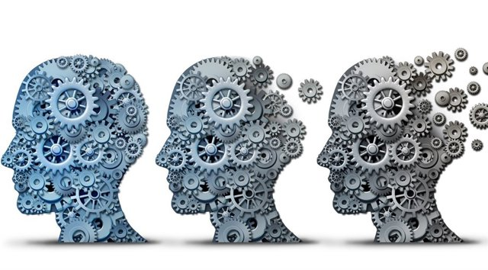
People loses their memory step by step due to this Alzheimer’s disease

Slide 8
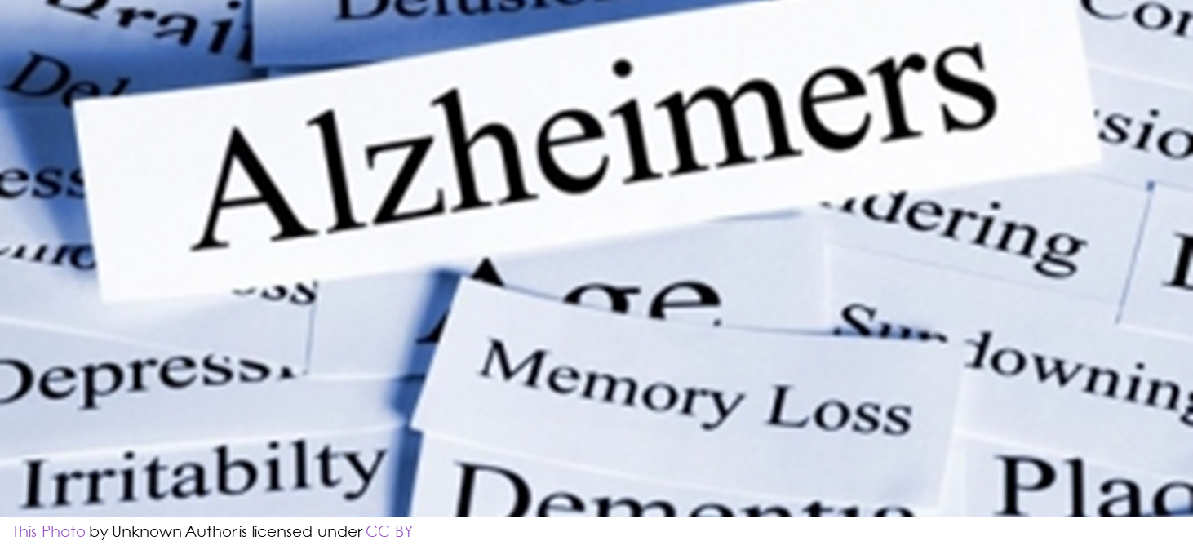

Slide 9
App idea
Android mobile
Wi-fi
Programming schedule
Reminders
Repeating time setting
APP SECURITY
APP PROCESSING
VOICE RECOGNITION

Slide 10


Lists of companies using AI in health care
Icarbonx
Babylon health
Yitu Technology
CARMAT
Bigfoot Biomedical
Pager
Zebra Medical Vision
Your.MD
Enlitic Inc

Slide 11
Desirability (user need)
Target users : Alzheimer’s patients and their caregivers.
Pain points : Memory lapses , missed medications , anxiety , `and caregiver stress.
Our app gently reminds users through familiar voices and videos , helping them stay calm and on track.

Slide 12
Feasibility
Tech stack :
-Frontend : React + Tailwind CSS
-Backend : Node.js + Express
-Database : Firebase / MongoDB
-Notifications : Firebase Cloud Messaging
-Video / Audio Handling : HTML5 APIs + Cloud storage

Slide 13
Viability:
Impact Model : reduces caregiver burden and enhances patient autonomy.
Scalable for elderly care , hospitals , and mental health support systems.
Potential revenue from subscription , partnerships with healthcare providers , or NGOs.

Slide 14
Prototype / Demo:
Prototype includes :
-Medication reminder screen
-Audio / video alert interface
-Caregiver dashboard
Demo showcases real-time notifications and visual alerts with patient – friendly design .

Slide 15
Teams & Roles :
Team members – Janani . G , Nivedhitha . V , Madhumitha . M , Senthamizh , Jeevitha.
Our team combines healthcare insight with software expertise to deliver compassionate technology solutions .

Slide 16
Ask
We seek mentorship , technical support , and healthcare partnerships to scale our Alzheimer’s reminder app .
We welcome collaboration for pilot testing and feedback from medical experts .

Slide 17
THANK YOU
Contact : nivedhithainfos@gmail.com , janani.giri@outlook.com
Gentle reminders -- “Because every memory. Matters"

